Slide 1
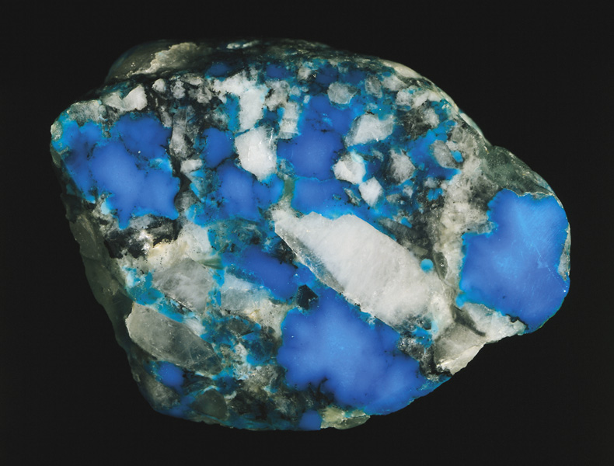
Chapter 25: Complex Ions and
Coordination Compounds
General Chemistry
Principles and Modern Applications
Petrucci • Harwood • Herring
8th Edition
Philip Dutton
University of Windsor, Canada
N9B 3P4
Prentice-Hall © 2002

Slide 2
Contents
25-1 Werner’s Theory of Coordination Compounds:
An Overview
25-2 Ligands
25-3 Nomenclature
25-4 Isomerism
25-5 Bonding in Complex Ions: Crystal Field Theory
25-6 Magnetic Properties of Coordination Compounds and Crystal Field Theory
25-7 Color and the Colors of Complexes

Slide 3
Contents
25-8 Aspects of Complex-Ion Equilibria
25-9 Acid-Base Reactions of Complex Ions
25-10 Nomenclature
25-11 Applications of Coordination Chemistry
Focus On Colors in Gemstones

Slide 4
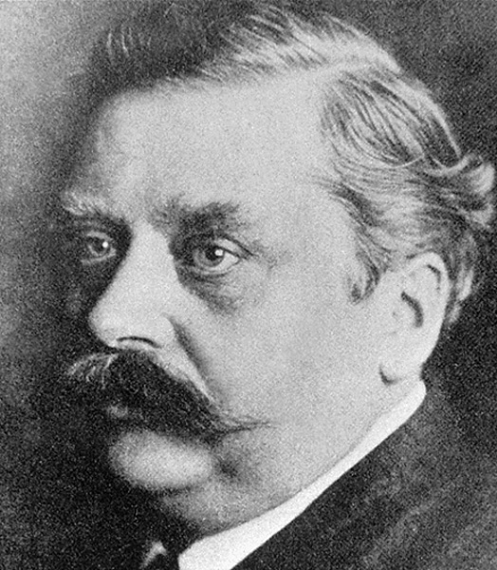
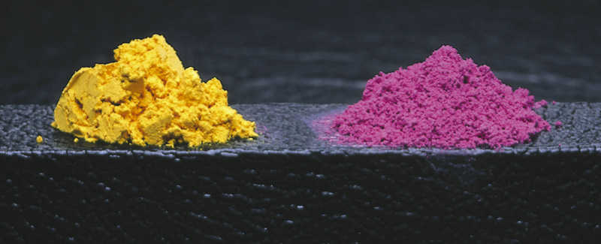
25-1Werner’s Theory of Coordination Compounds: An Overview
Compounds made up of simpler compounds are called coordination compounds.
CoCl₃ and NH₃.
  CoCl₃· (NH₃)₆ and CoCl₃· (NH₃)₅.
  Differing reactivity with AgNO₃.

Slide 5
Werner’s Theory
Two types of valence or bonding capacity.
  Primary valence.
    Based on the number of e⁻ an atom loses in forming the ion.
  Secondary valence.
    Responsible for the bonding of other groups, called ligands, to the central metal atom.
[Co(NH₃)₆]Cl₃ → [Co(NH₃)₆]³⁺ + 3 Cl⁻
[CoCl(NH₃)₅]Cl₂ → [CoCl(NH₃)₅]³⁺ + 2 Cl⁻

Slide 6
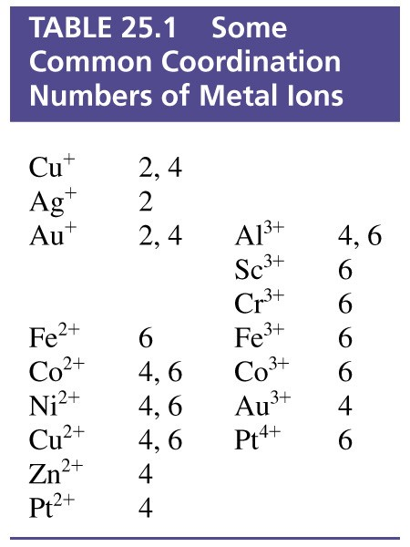
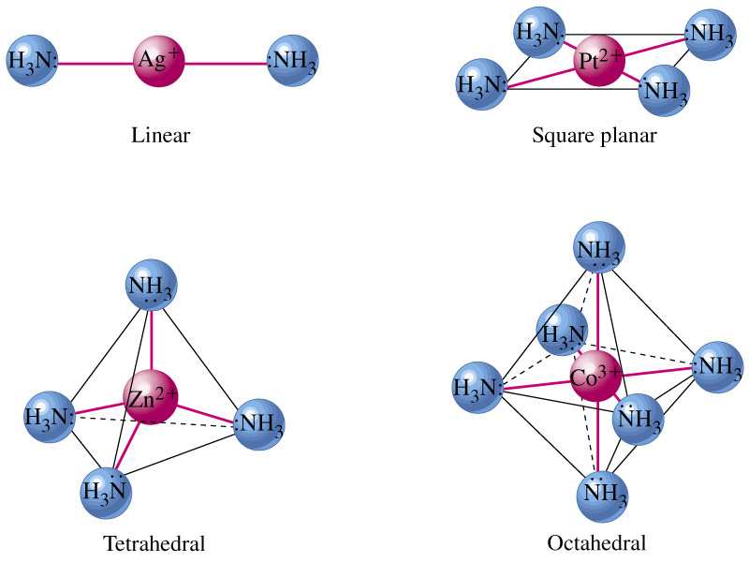
Coordination Number

Slide 7
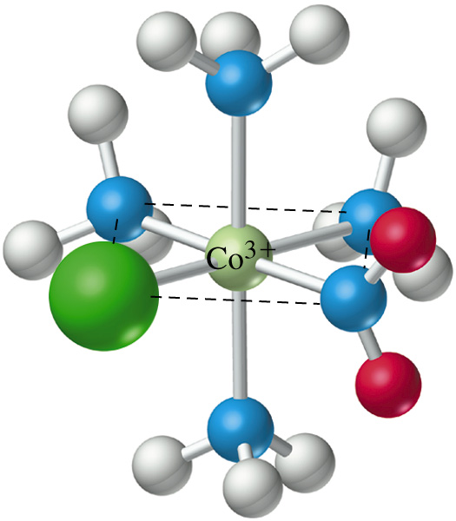
Example 25-1
Relating the Formula of a Complex to the Coordination Number and Oxidation State of the Central Metal.
What are the coordination number and oxidation state of Co in the complex ion [CoCl(NO₂)(NH₃)₄]⁺?
Solution:
The complex has as ligands
1Cl, 1NO₂, 4NH₃ .
The coordination number is 6.

Slide 8
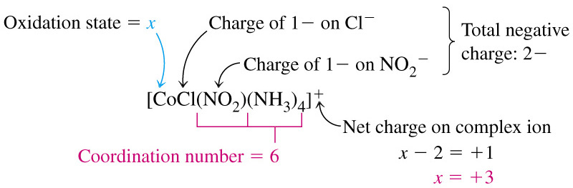
Example 25-1
Charge on the metal ion:

Slide 9
25-2 Ligands
Ligands are Lewis bases.
  Donate electron pairs to metals (which are Lewis acids).
Monodentate ligands.
  Use one pair of electrons to form one point of attachment to the metal ion.
Bidentate ligands.
  Use two pairs of electrons to form two points of attachment to the metal ion.
Tridentate, tetradentate…..polydentate

Slide 10
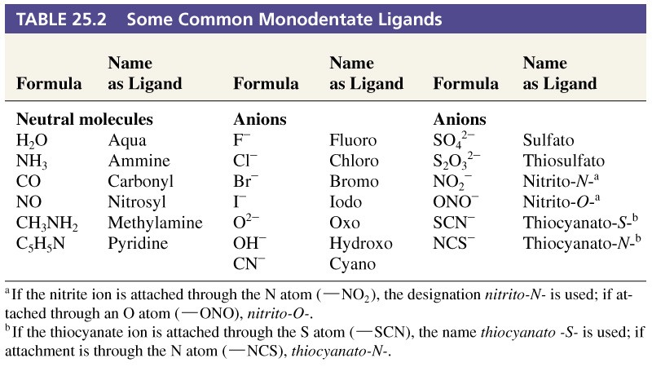
Table 25.2 Some Common Monodentate Ligands.

Slide 11
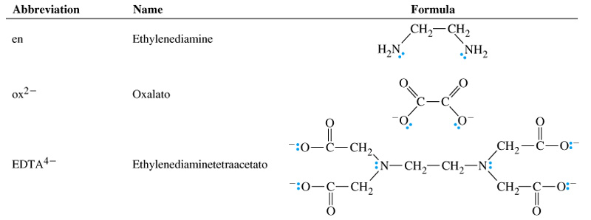
Table 25.3 Some Common Polydentate Ligands (Chelating Agents)

Slide 12
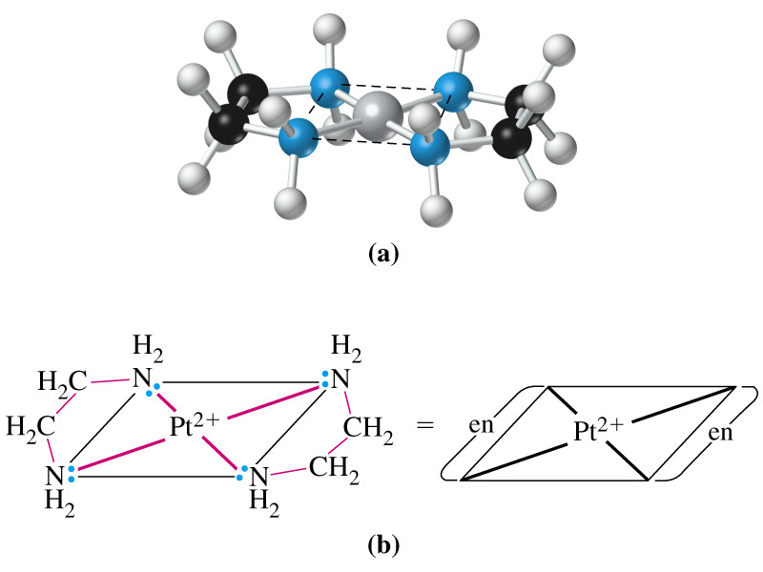
Ethylene Diamine

Slide 13
25-3 Nomenclature
In names and formulas of coordination compounds, cations come first, followed by anions.
Anions as ligands are named by using the ending –o.
  Normally
    – ide endings change to –o.
    – ite endings change to –ito.
    – ate endings change to –ato.
Neutral molecules as ligands generally carried the unmodified name.

Slide 14
Nomenclature
The number of ligands of a given type is given by a prefix.
    Mono, di, tri, tetra, penta, hexa…
  If the ligand name is a composite name itself
    Place it in brackets and precede it with a prefix:
      Bis, tris, tetrakis, pentakis...

Slide 15
Nomenclature
Name the ligands first, in alphabetical order, followed by the name of the metal centre.
  Prefixes are ignored in alphabetical order decisions.
The oxidation state of the metal centre is given by a Roman numeral.
If the complex is an anion the ending –ate is attached to the name of the metal.

Slide 16
Nomenclature
When writing the formula
    the chemical symbol of the metal is written first,
    followed by the formulas of anions,
      in alphabetical order.
    and then formulas of neutral molecules,
      in alphabetical order.

Slide 17
25-4 Isomerism
Isomers.
  Differ in their structure and properties.
Structural isomers.
  Differ in basic structure.
Stereoisomers.
  Same number and type of ligands with the same mode of attachement.
  Differ in the way the ligands occupy space around the metal ion.

Slide 18
Examples of Isomerism
Ionization Isomerism
[CrSO₄(NH₃)₅]Cl
[CrCl(NH₃)₅]SO₄
pentaaminsulfatochromium(III) chloride
pentaaminchlorochromium(III) sulfate
Coordination Isomerism
[Co(NH₃)₆][CrCN₆]
[Cr(NH₃)₆][CoCN₆]
hexaaminecobalt(III) hexacyanochromate(III)
hexaaminechromium(III) hexacyanocobaltate(III)

Slide 19
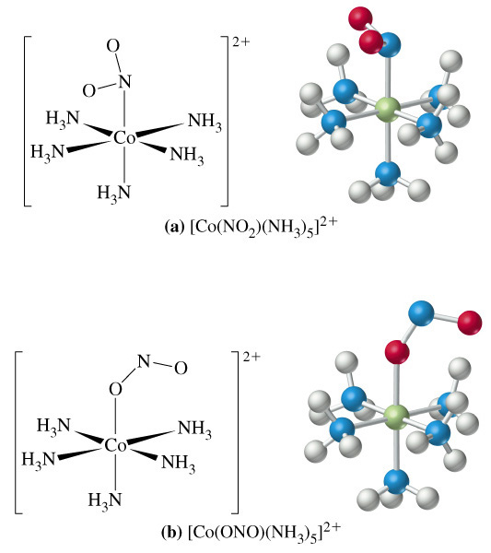
Linkage Isomerism

Slide 20
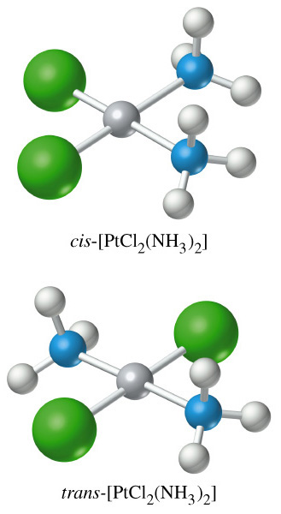
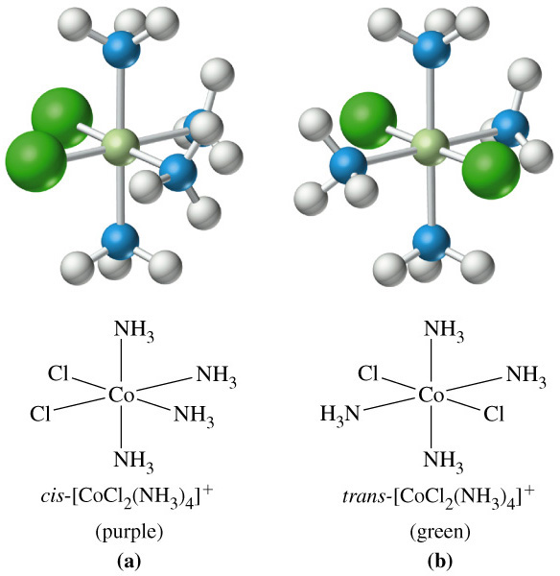
Geometric Isomerism

Slide 21
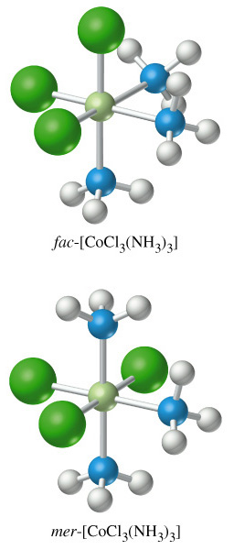
Geometric Isomerism

Slide 22
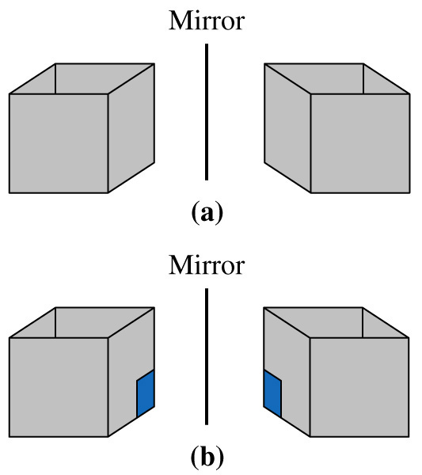
Optical Isomerism

Slide 23
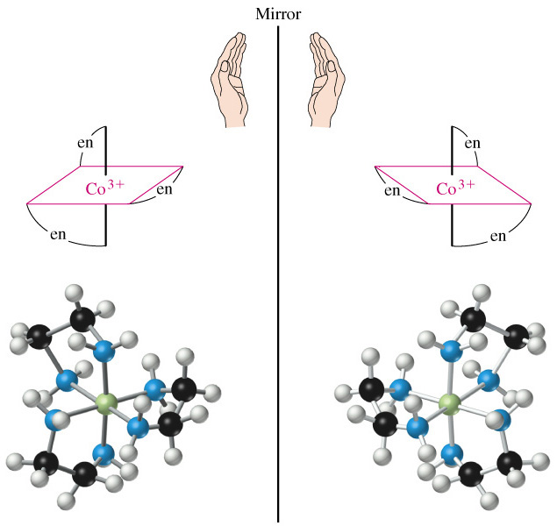
Optical Isomerism

Slide 24
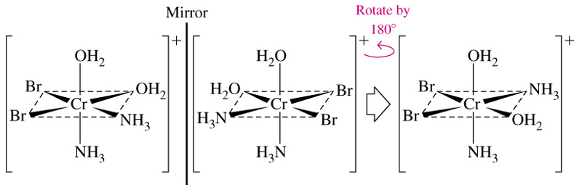
Mirror Images

Slide 25
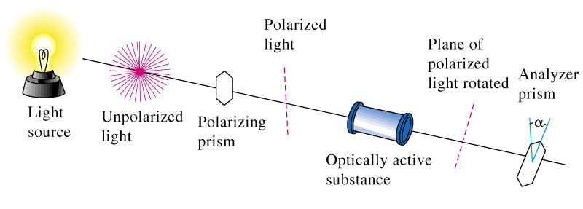
Optical Activity
dextrorotatory d-
levorotatory l-

Slide 26
25-5 Bonding in Complex Ions:
Crystal Field Theory
Consider bonding in a complex to be an electrostatic attraction between a positively charged nucleus and the electrons of the ligands.
  Electrons on metal atom repel electrons on ligands.
  Focus particularly on the d-electrons on the metal ion.

Slide 27
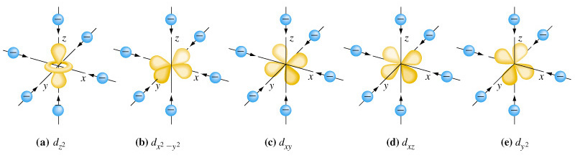
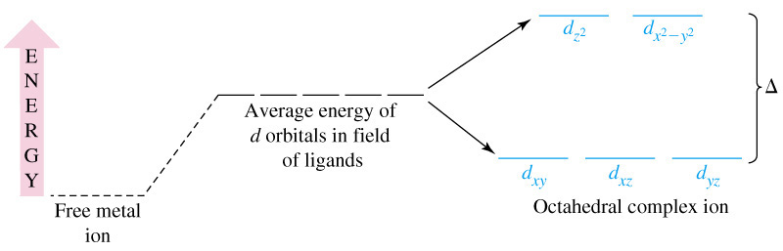
Octahedral Complex and d-Orbital Energies

Slide 28
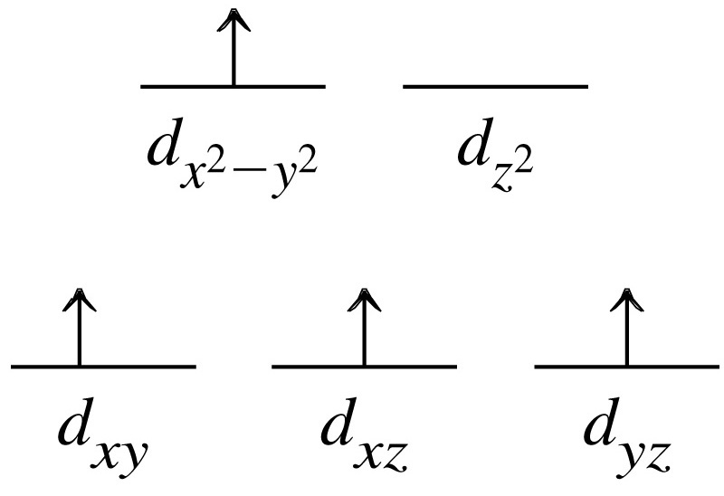
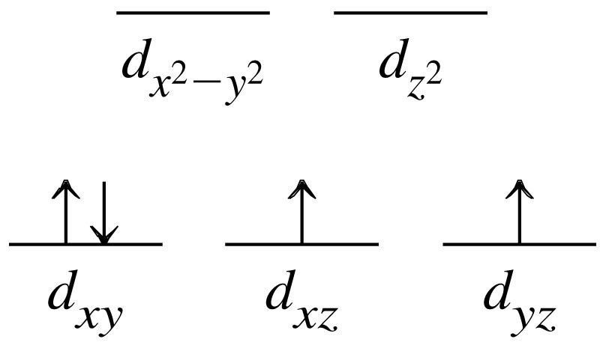
Electron Configuration in d-Orbitals
Δ
P
Hund’s rule
pairing energy considerations
Δ > P
low spin d⁴
Δ < P
high spin d⁴

Slide 29
Spectrochemical Series
Large Δ
Strong field ligands
CN⁻ > NO₂⁻ > en > py  NH₃ > EDTA⁴⁻ > SCN⁻ > H₂O >
ONO⁻ > ox²⁻ > OH⁻ > F⁻ > SCN⁻ > Cl⁻ > Br⁻ > I⁻
Small Δ
Weak field ligands

Slide 30
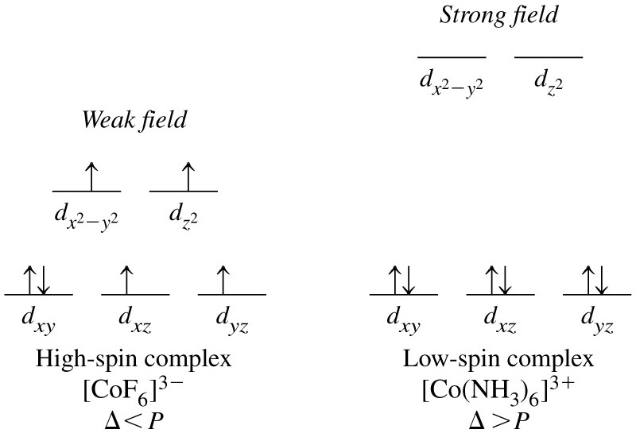
Weak and Strong Field Ligands
Two d⁶ complexes:

Slide 31
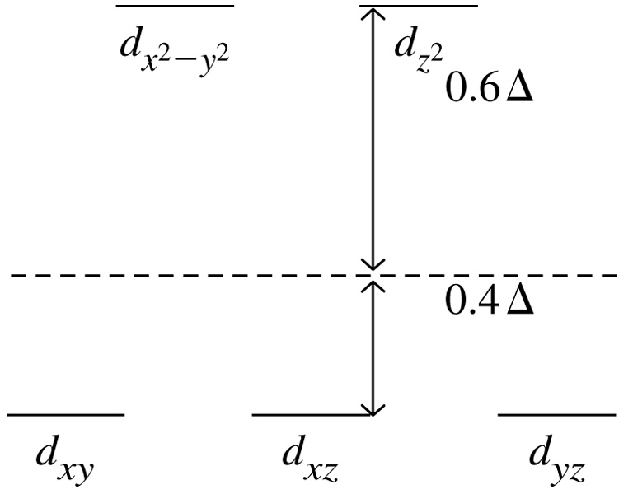
Energy Effects in a d¹⁰ System

Slide 32
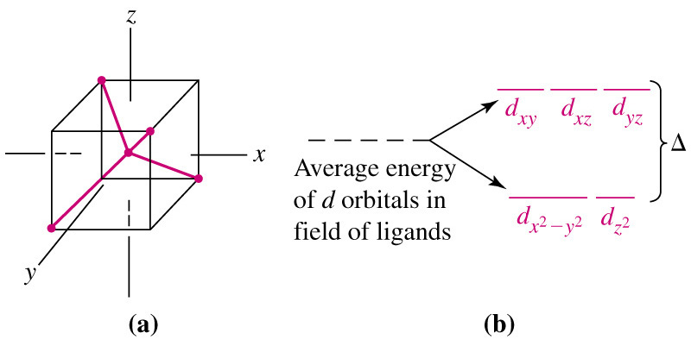
Tetrahedral Crystal Field

Slide 33
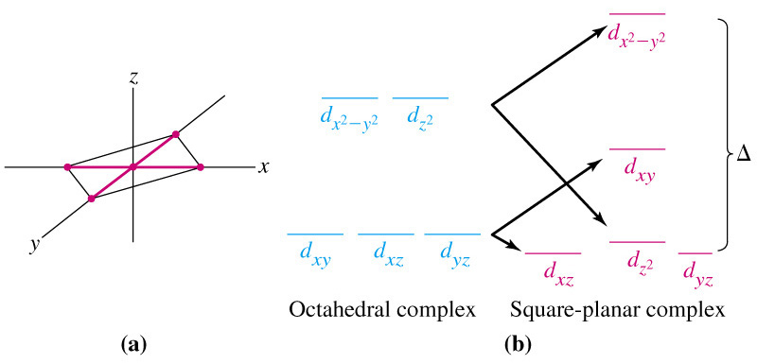
Square Planar Crystal Field

Slide 34
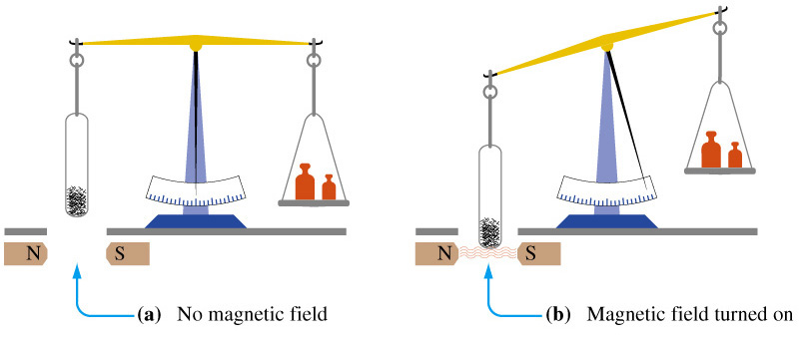
25-6 Magnetic Properties of Coordination Compounds and Crystal Field Theory.
Paramagnetism illustrated:

Slide 35
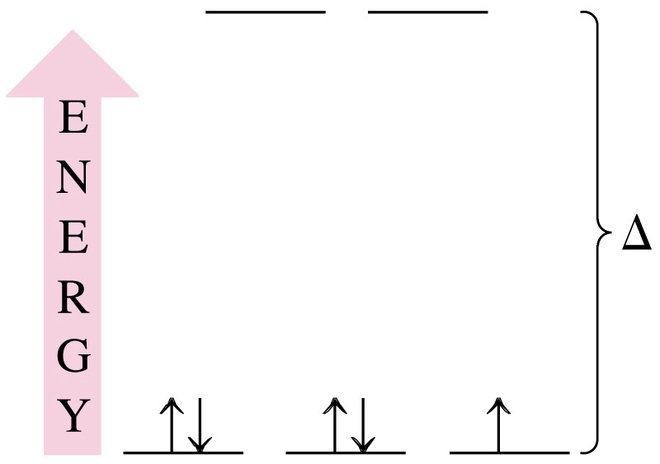
Example 25-4
Using the Spectrochemical Series to Predict Magnetic Properties.
How many unpaired electrons would you expect to find in the octahedral complex [Fe(CN)₆]³⁻?
Solution:
Fe [Ar]3d⁶4s²
Fe³⁺ [Ar]3d⁵

Slide 36
Example 25-5
Using the Crystal Field theory to Predict the Structure of a Complex from Its Magnetic Properties.
The complex ion [Ni(CN₄)]²⁻ is diamagnetic. Use ideas from the crystal field theory to speculate on its probably structure.
Solution:
Coordination is 4 so octahedral complex is not possible.
Complex must be tetrahedral or square planar.
Draw the energy level diagrams and fill the orbitals with e⁻.
Consider the magnetic properties.

Slide 37
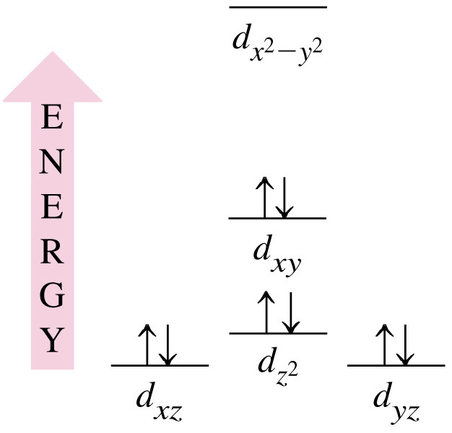
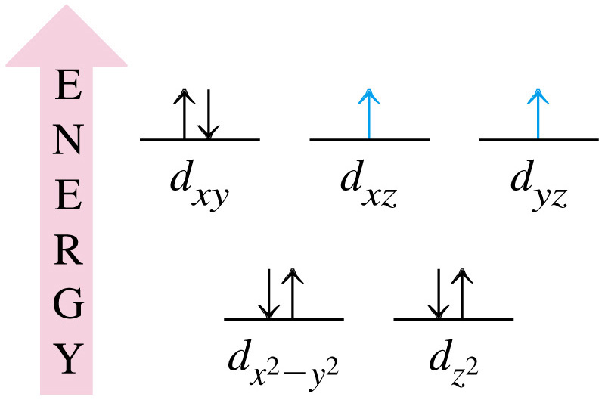
Example 25-5
Tetrahedral:
Square planar:

Slide 38
25-7 Color and the Colors of Complexes
Primary colors:
  Red (R), green (G) and blue (B).
Secondary colors:
  Produced by mixing primary colors.
Complementary colors:
  Secondary colors are complementary to primary.
  Cyan (C), yellow (Y) and magenta (M)
  Adding a color and its complementary color produces white.

Slide 39
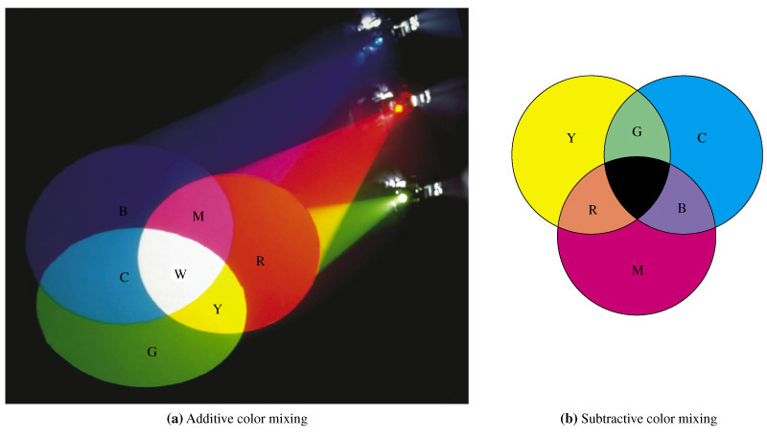
Color and the Colors of Complexes

Slide 40
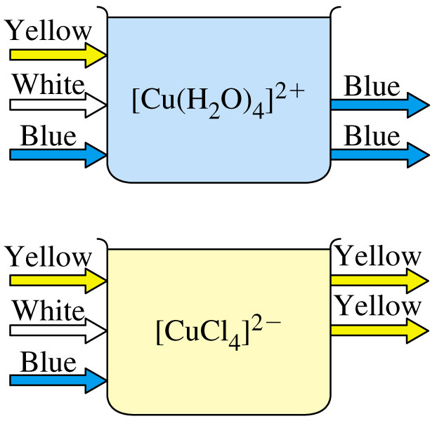

Slide 41
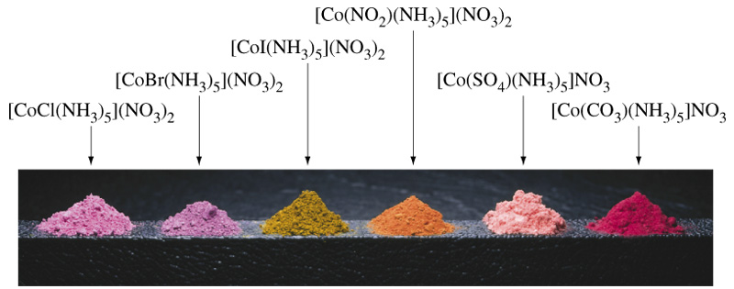
Effect of Ligands on the Colors of Coordination Compounds

Slide 42
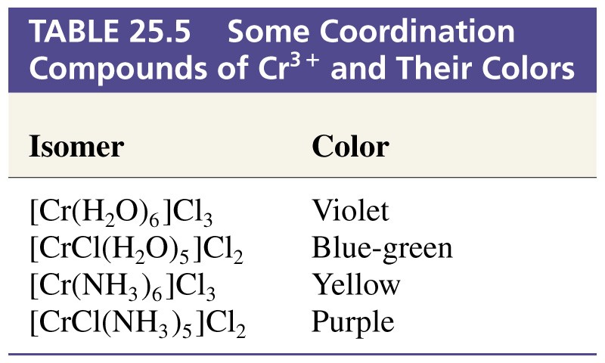
Table 25.5 Some Coordination Compounds of Cr³⁺ and Their Colors

Slide 43
25-8 Aspects of Complex-Ion Equilibria
Zn²⁺(aq) + 4 NH₃(aq)  [Zn(NH₃)₄]²⁺(aq)
[[Zn(NH₃)₄]²⁺]
K_{f} =
= 4.110⁸
[Zn²⁺][NH₃]⁴
Displacement is stepwise from the hydrated ion:
Step 1:
[Zn(H₂O)₄]²⁺(aq) + NH₃(aq)  [Zn(H₂O)₃(NH₃)]²⁺(aq) + H₂O(aq)
[[Zn(H₂O)₃(NH₃)]²⁺]
K₁=
= β₁ = 3.910²
[[Zn(H₂O)₄]²⁺][NH₃]

Slide 44
25-8 Aspects of Complex-Ion Equilibria
Step 2:
[Zn(H₂O)₃(NH₃)]²⁺(aq) + NH₃(aq)  [Zn(H₂O)₂(NH₃)₂]²⁺(aq) + H₂O(aq)
[[Zn(H₂O)₂(NH₃)₂]²⁺]
K₂ =
= 2.110²
[[Zn(H₂O)₃(NH₃)]²⁺][NH₃]
Combining steps 1 and 2:
[Zn(H₂O)₄]²⁺(aq) + 2 NH₃(aq)  [Zn(H₂O)₂(NH₃)₂]²⁺(aq) + 2 H₂O(aq)
[[Zn(H₂O)₂(NH₃)₂]²⁺]
K = β₂ =
= K₁  K₂ = 8.210⁴
[[Zn(H₂O)₄]²⁺][NH₃]²

Slide 45
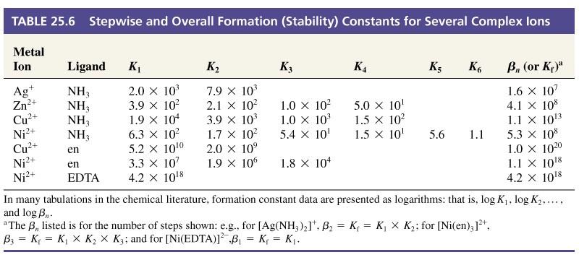
Aspects of Complex Ion Equilibria
β₄ = K₁  K₂  K₃  K₄ = K_{f}

Slide 46
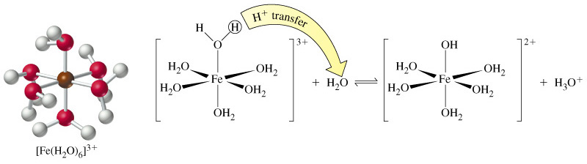
24-9 Acid-Base Reactions of Complex Ions
[Fe(H₂O)₆]³⁺(aq) + H₂O(aq)  [Fe(H₂O)₅(OH)]²⁺(aq) + H₃O⁺(aq)
K_{a1} = 910⁻⁴
[Fe(H₂O)₅(OH)]²⁺ (aq) + H₂O(aq)  [Fe(H₂O)₄(OH)₂]²⁺(aq) + H₃O⁺(aq)
K_{a2} = 510⁻⁴

Slide 47
25-10 Some Kinetic Considerations
fast
[Cu(H₂O)₄]²⁺ + 4 NH₃ → [Cu(NH₃)₄]²⁺ + 4 H₂O
fast
[Cu(H₂O)₄]²⁺ + 4 Cl⁻ → [Cu(Cl)₄]²⁻ + 4 H₂O
Water is said to be a labile ligand.
Slow reactions (often monitored by color change) are caused by non-labile ligands.

Slide 48
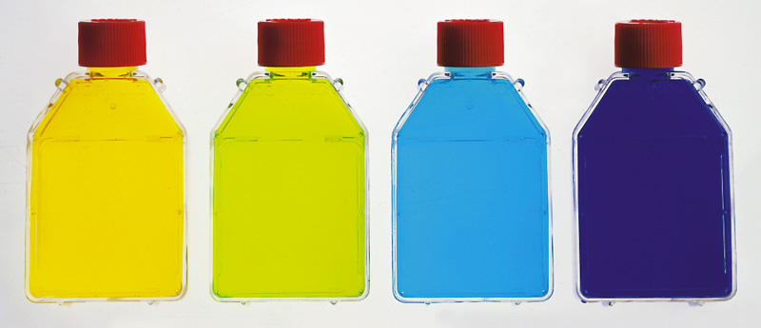
25-11 Applications of Coordination Chemistry
Hydrates
  Crystals are often hydrated.
  Fixed number of water molecules per formula unit.

Slide 49
Stabilization of Oxidation States
Co³⁺(aq) + e⁻ → Co²⁺(aq) E° = +1.82 V
4 Co³⁺(aq) + 2 H₂O(l) → 4 Co²⁺(aq) + 4 H⁺ + O₂(g)
E°_{cell} = +0.59 V
But:
Co³⁺(aq) + NH₃(aq) → [Co(NH₃)₆]²⁺(aq)
K_{f} = 4.510³³
and
[Co(NH₃)₆]³⁺(aq) + e⁻ → [Co(NH₃)₆]²⁺(aq)
E° = +0.10 V

Slide 50
Photography: Fixing a Photographic Film
Black and white.
  Finely divided emulsion of AgBr on modified cellulose.
  Photons oxidize Br⁻ to Br and reduce Ag⁺ to Ag.
Hydroquinone (C₆H₄(OH)₂) developer:
  Reacts only at the latent image site where some Ag⁺ is present and converts all Ag⁺ to Ag.
  Negative image.
Fixer removes remaining AgBr.
AgBr(s) + 2 S₂O₃²⁻(aq) → [Ag(S₂O₃)₂]³⁻(aq) + Br⁻(aq)
Print the negative

Slide 51
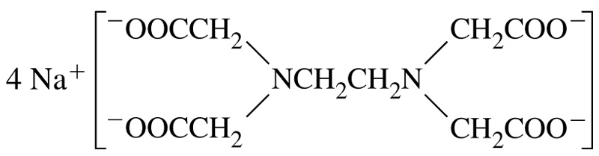
Sequestering Metal Cations
tetrasodium EDTA

Slide 52
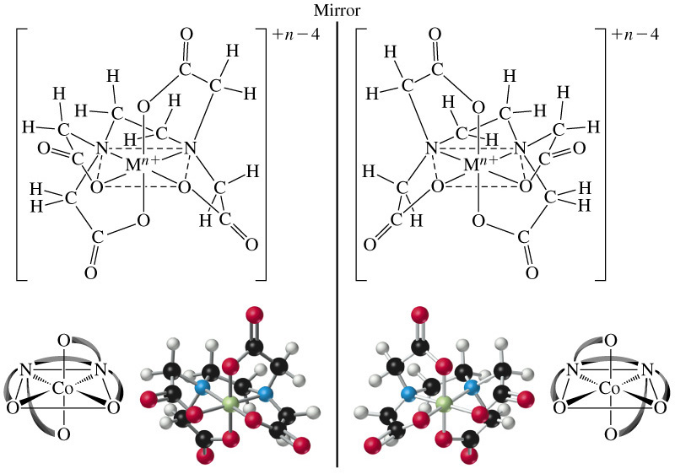
Sequestering Metal Cations
Some Log β values: 10.6 (Ca²⁺), 18.3 (Pb²⁺), 24.6 (Fe³⁺).

Slide 53
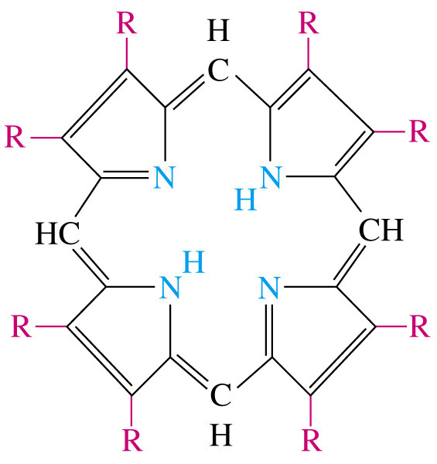
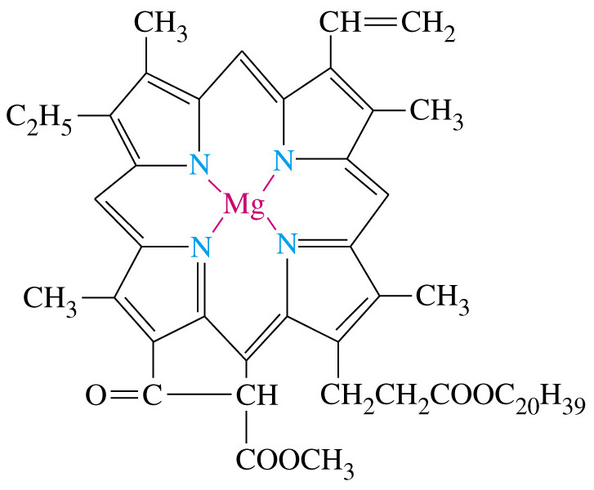
Biological Applications
porphyrin
chlorophyl a

Slide 54
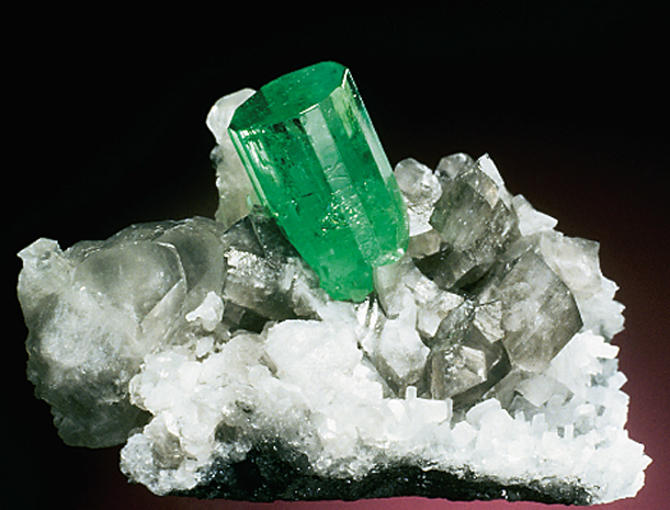
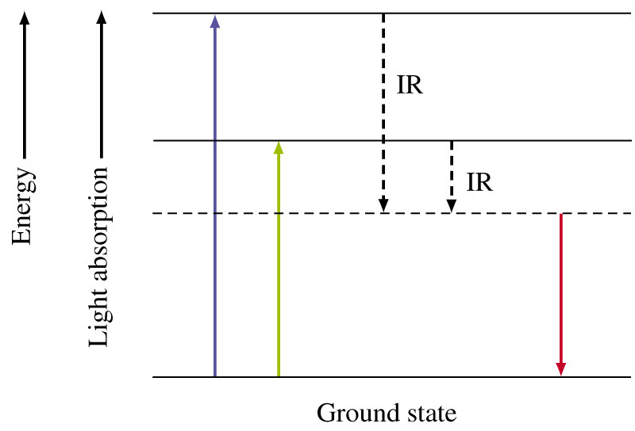
Focus On Colors in Gemstones
Emerald
3BeO·Al₂O₃ ·6SiO₂
+ Cr³⁺ in Al³⁺ sites
Ruby
Al₂O₃ + Cr³⁺ in Al³⁺ sites

Slide 55
Chapter 25 Questions
Develop problem solving skills and base your strategy not on solutions to specific problems but on understanding.
Choose a variety of problems from the text as examples.
Practice good techniques and get coaching from people who have been here before.

